Slide 1


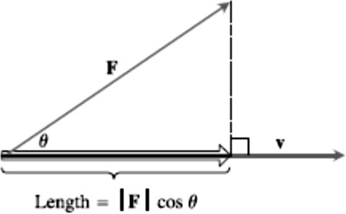
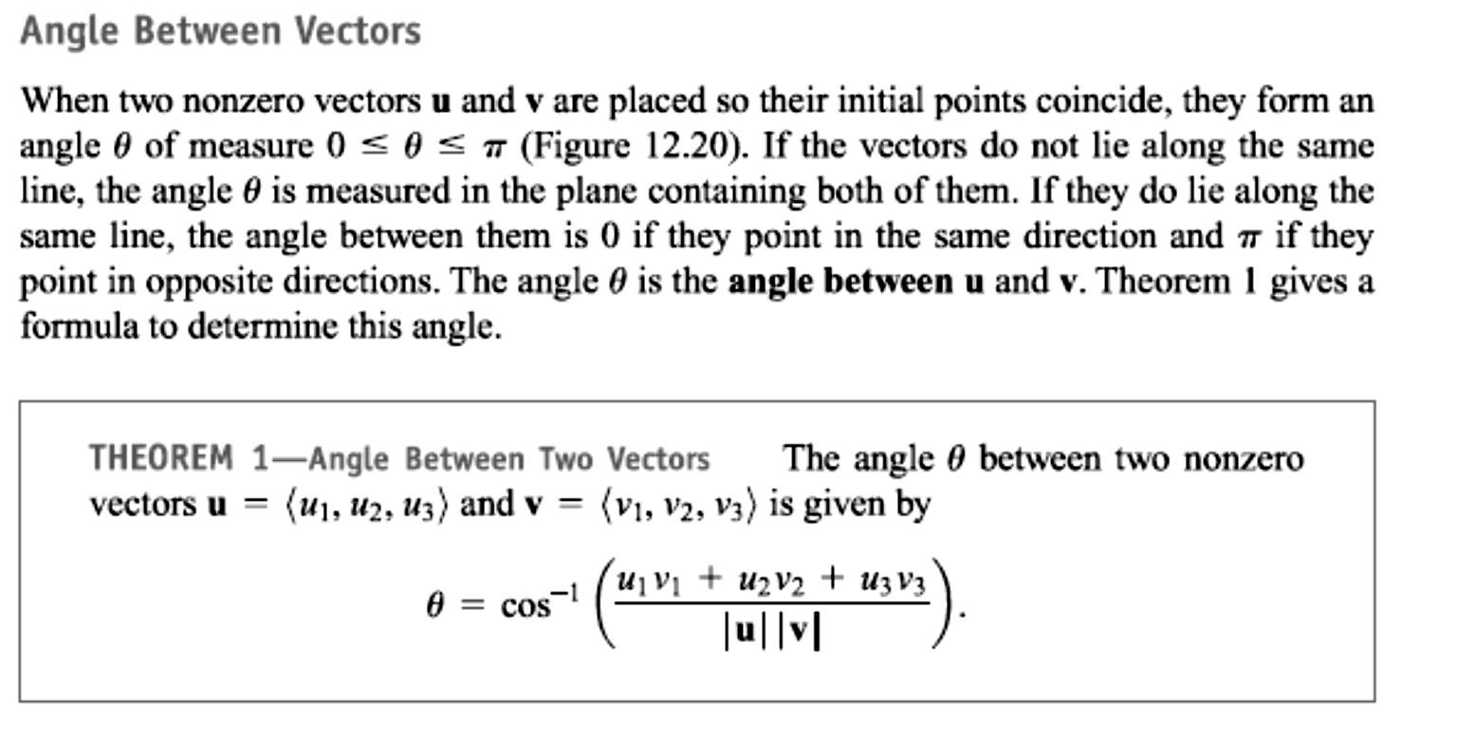

8 / Dep. Of Engineering Mechanics
Class: 2th AMTHMATICS / The vector

Slide 2


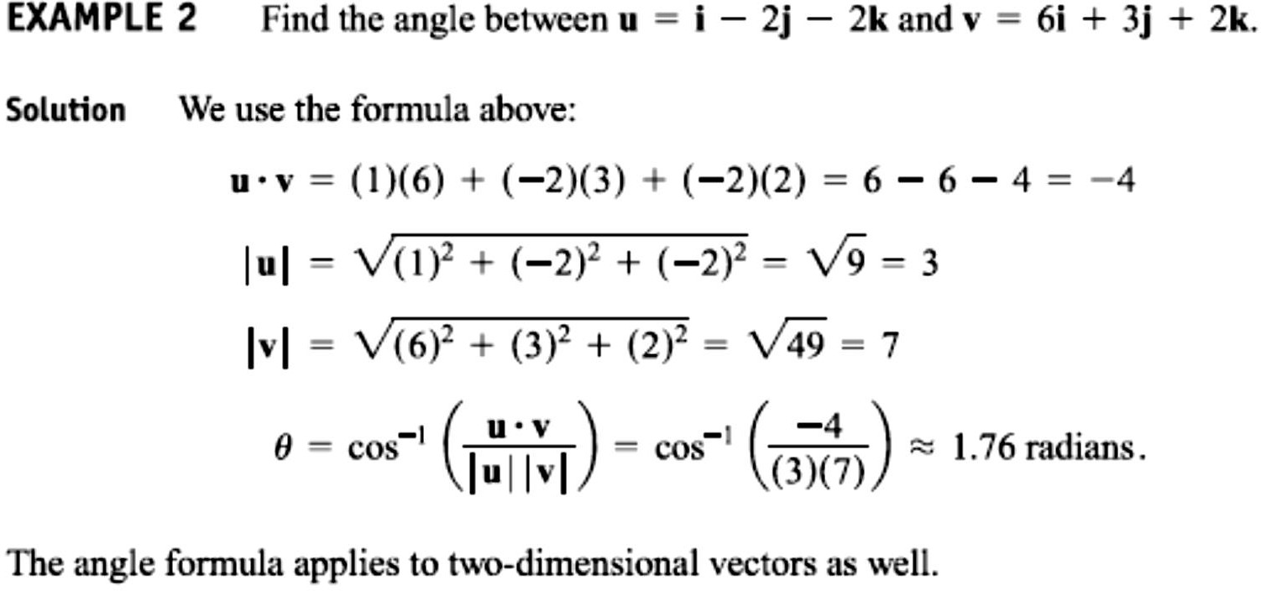
9 / Dep. Of Engineering Mechanics
Class: 2th AMTHMATICS / The vector

Slide 3
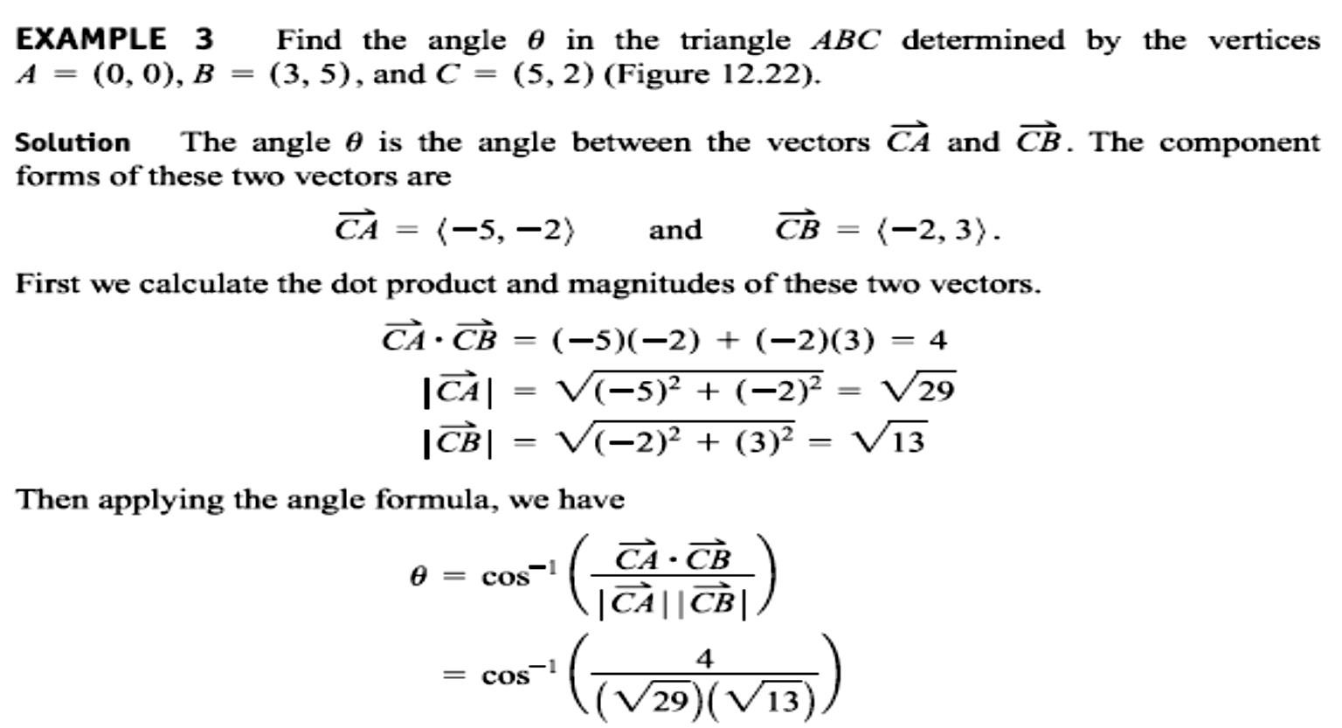
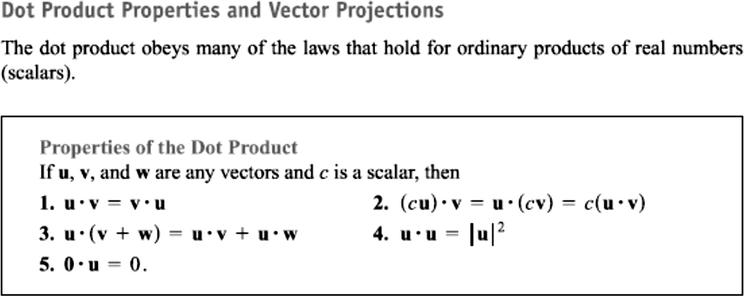

Slide 4
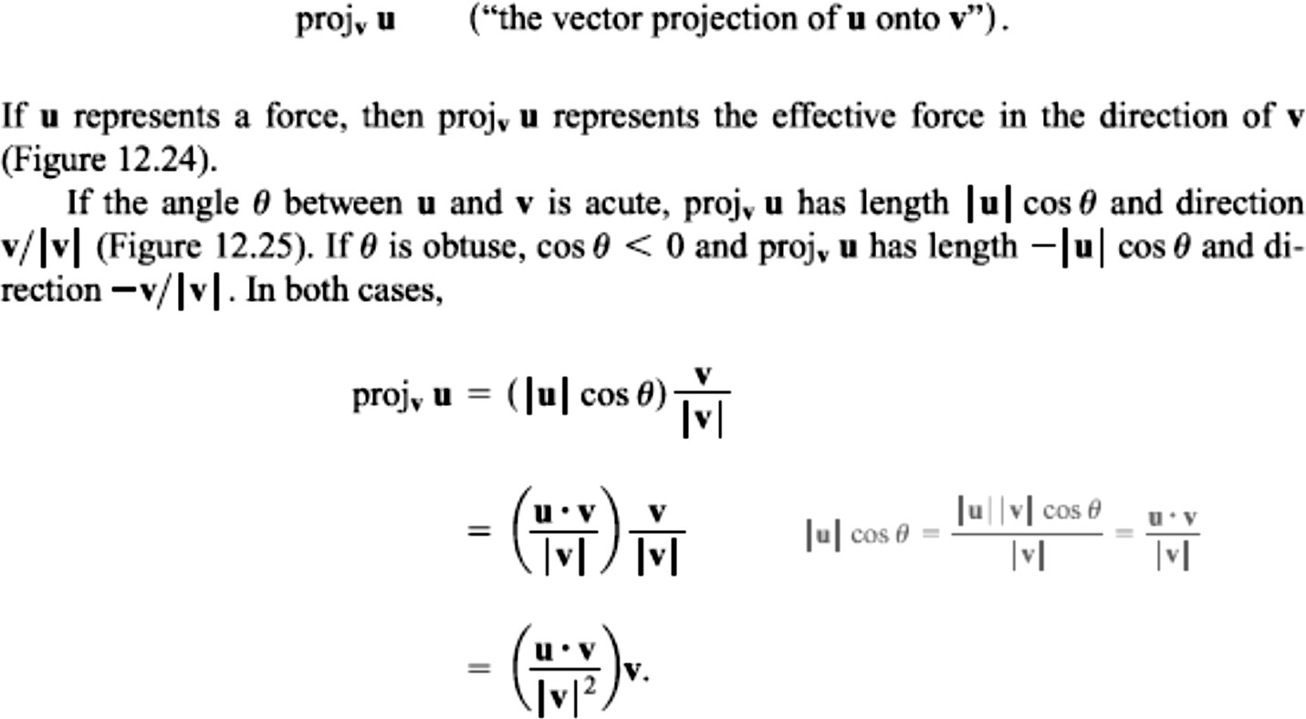
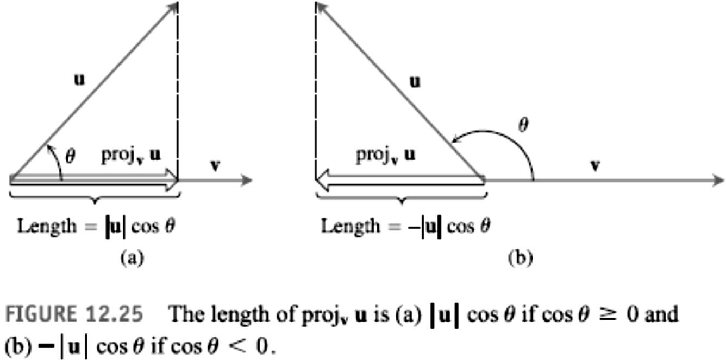
10 / Dep. Of Engineering Mechanics
Class: 2th AMTHMATICS / The vector

Slide 5
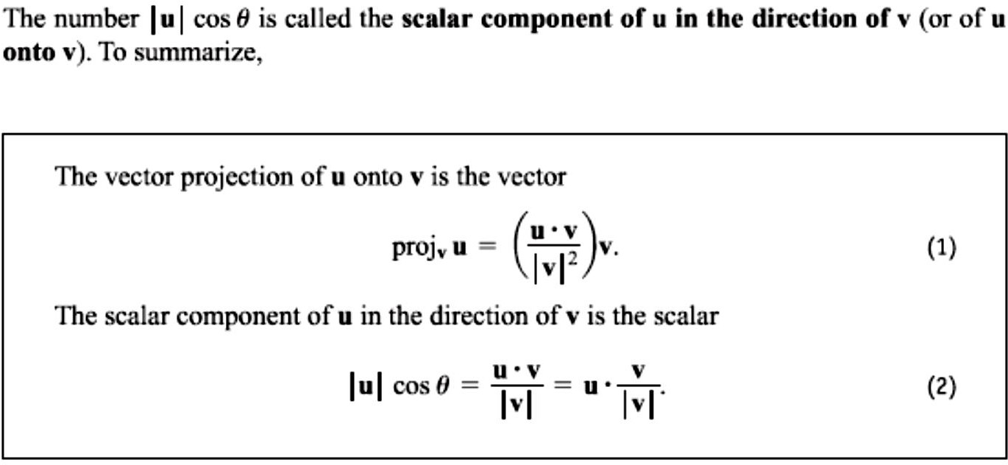
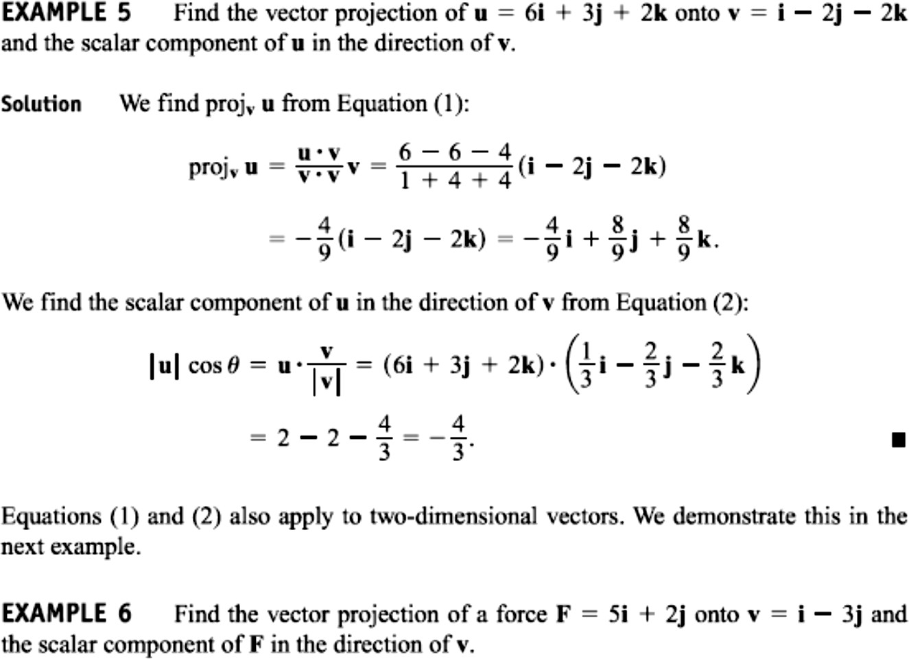
11 / Dep. Of Engineering Mechanics
Class: 2th AMTHMATICS / The vector

Slide 6
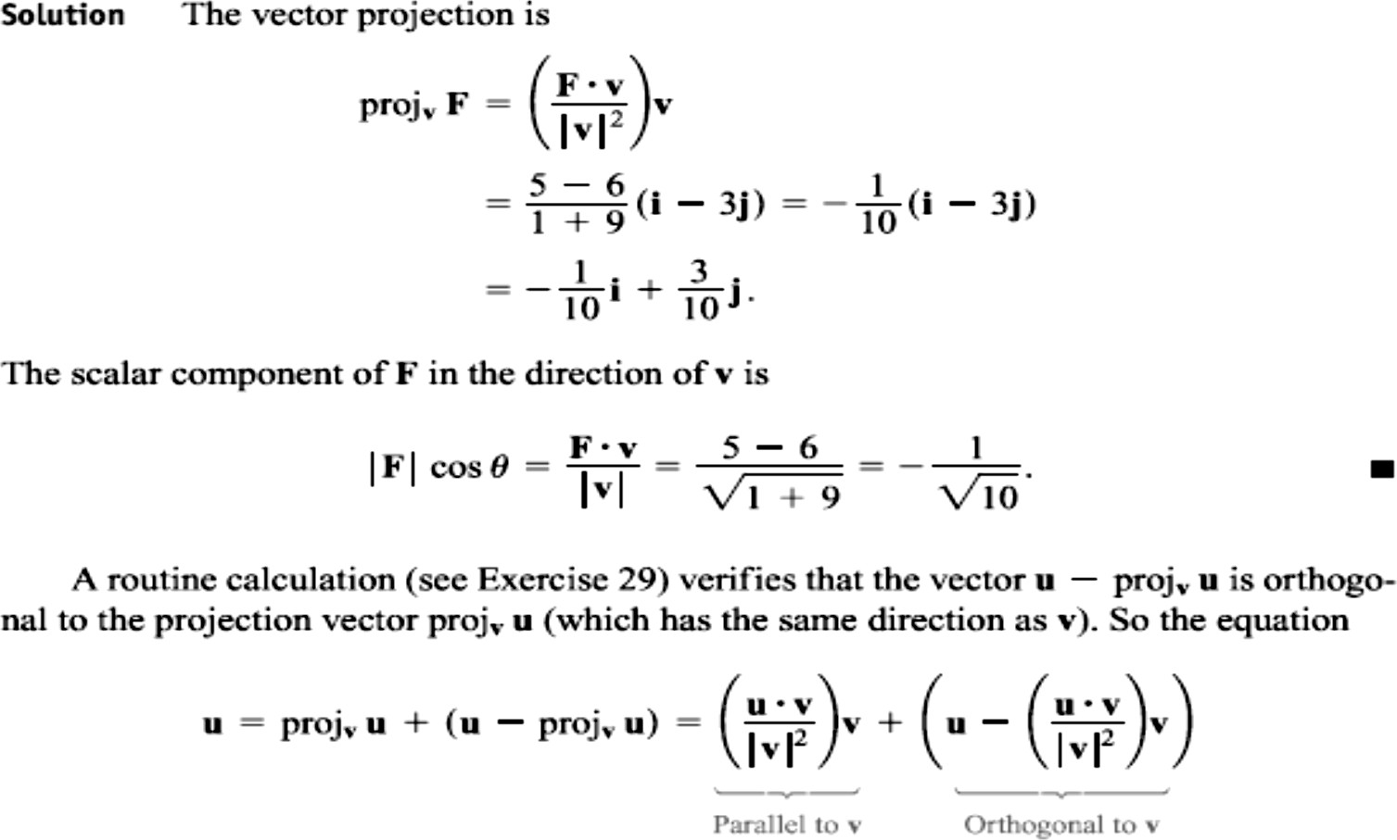
12 / Dep. Of Engineering Mechanics
Class: 2th AMTHMATICS / The vector

Slide 7
